Slide 1
Making an Insect with recycled material

Slide 2
Introduction
If you're looking to make something useful out of something recycled, you may be surprised by just how many items you can reuse creatively.

Slide 3
What things can be recycled?
Glass bottles.
Plastic bottles.
Paper rolls (from kitchen towel and toilet paper)
Stale bread.
Clothes.
Books.
Vegetable peelings.
Plastic Pots.

Slide 4
For example
Litter Bugs
Use soap and water to thoroughly clean an empty foam egg carton. Allow it to dry completely.
Use a pair of scissors to cut off the cups of the clean egg carton.
Use recycled material such as foam peanuts, plastic soda bottle lids, sticks and old twist ties to decorate your litter bug.

Slide 5
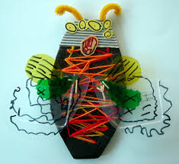

Slide 6
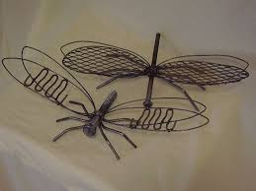

Slide 7
